Slide 1
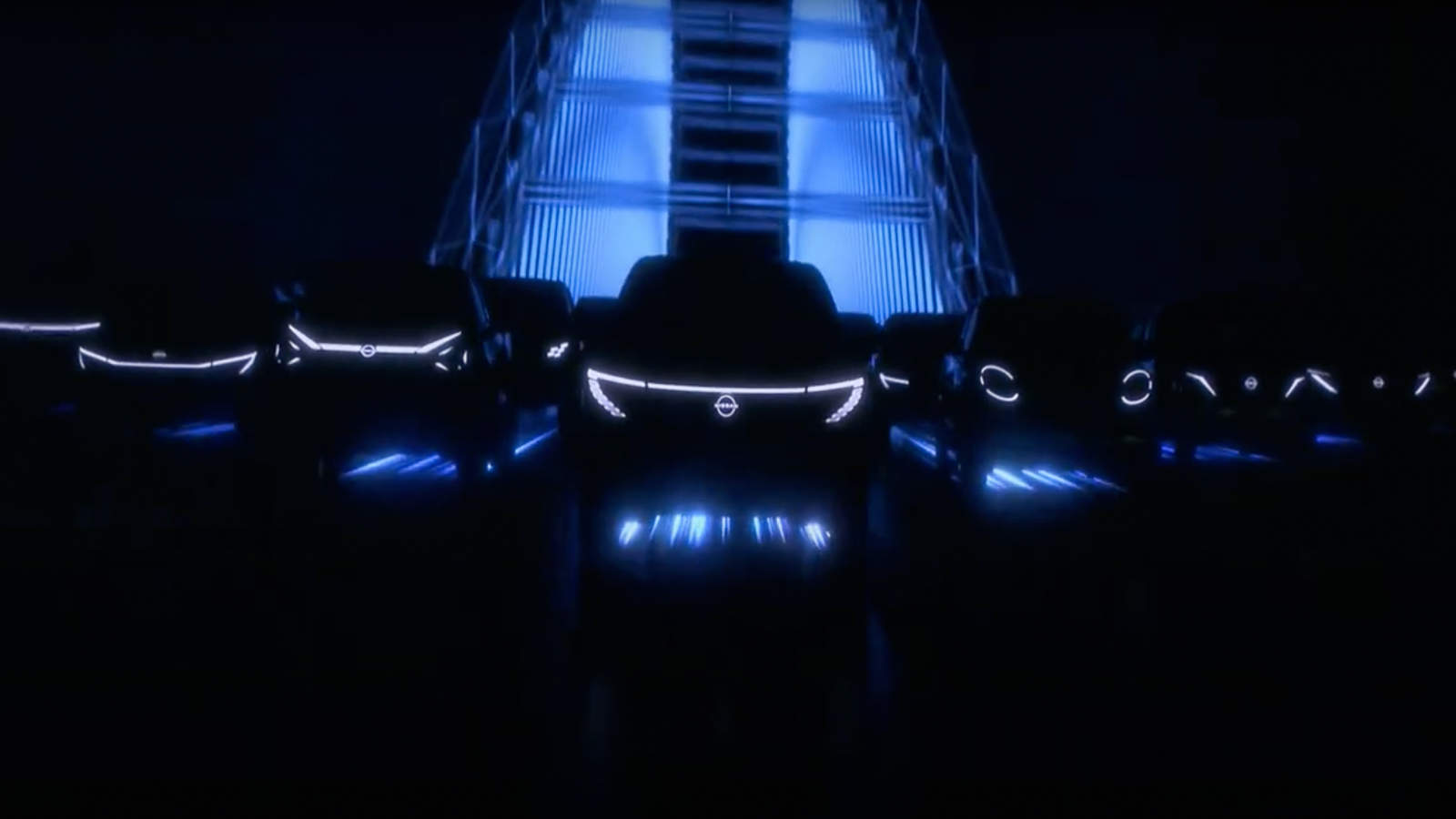
Project 1 Group 1
Chase Arnett, Jordan Graves, Shanice Cummings, Jonathan Lockridge
10/23/24

Slide 2
Executive Summary
CSV from Kaggle.com.
The CSV is called EV Data Set from 2020 Census in WA state.
Determination to conclude is BEV or PHEV more popular.
Range trends that PHEV and BEV have in commonality if any.
Sales trends between each PHEV and BEV.

Slide 3
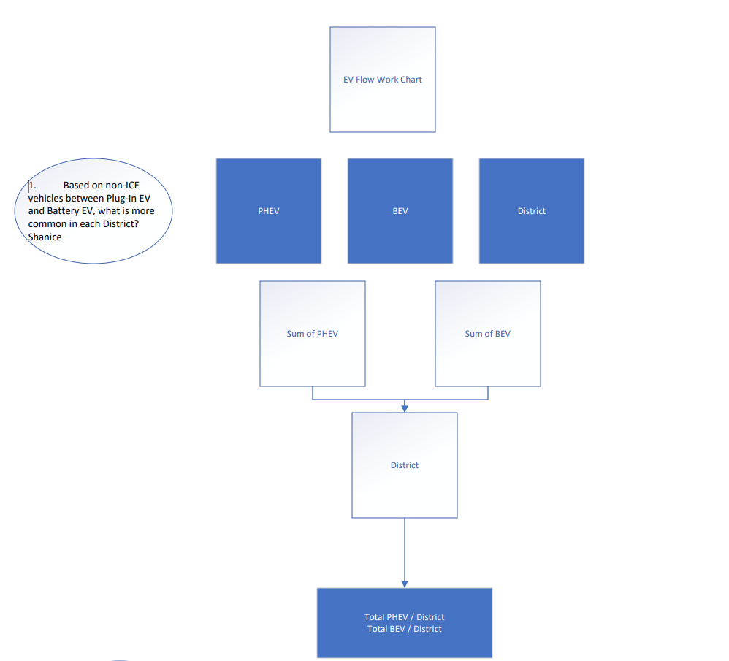
Data Mapping Q1 ( Shanice )

Slide 4
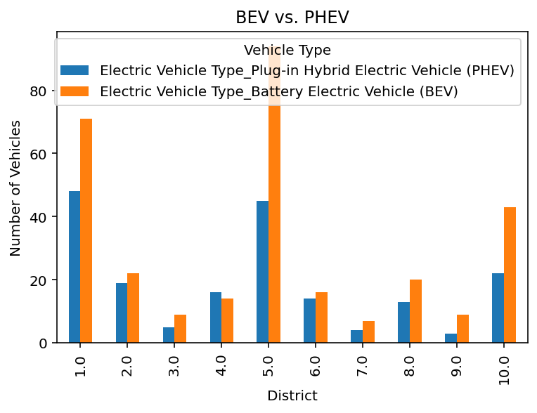
Based on non-ICE vehicles between Plug-In EV and Battery EV, what is more common in each District?
According to the data, Battery Electric Vehicles are the most common in each district.

Slide 5
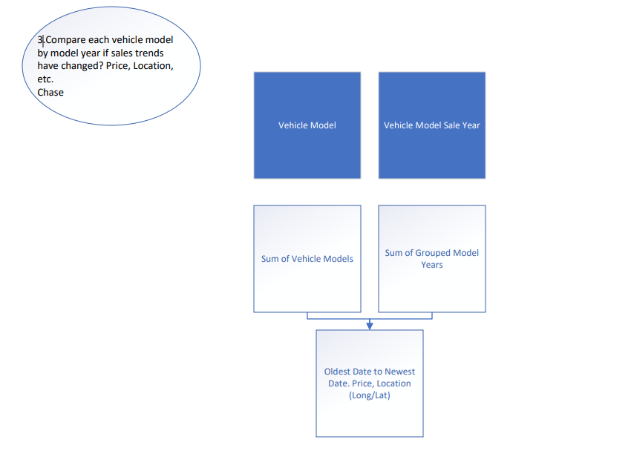
Data Mapping Q2 ( Chase )

Slide 6
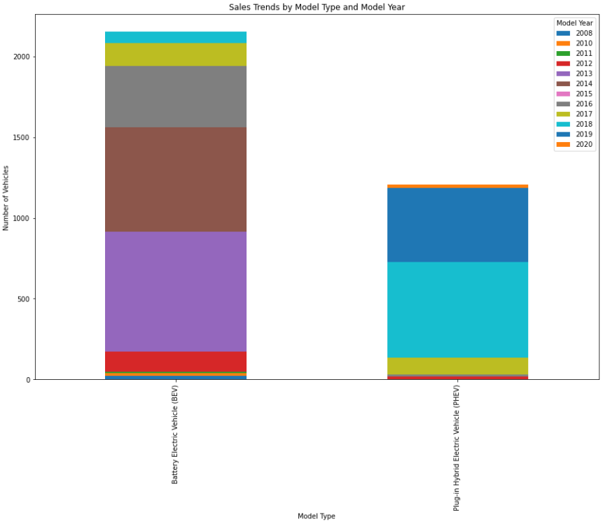
Based on the 2020 Census tract, more BEV’s have been purchased over 12 years than PHEV.
BEV
PHEV
2013, 2014, and 2016 are the greatest Model Years sold.
BEV has more sold vehicles.
PHEV sold 1300 vehicles in 12 years.
2018 and 2019 are the top two Sale years.

Slide 7
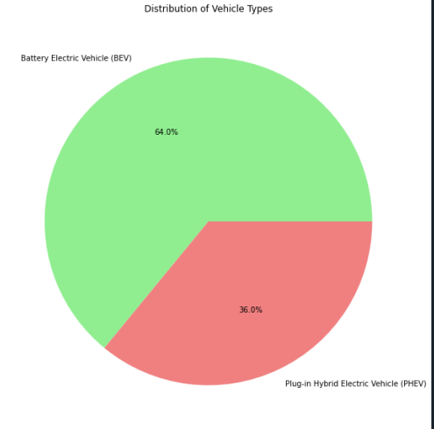
The Census data concluded that from 2008 to 2020 64% of sales in WA are BEV.
PHEV is 34% from 2008 to 2020. Conclusion PHEV with limited range is driving Sales.

Slide 8
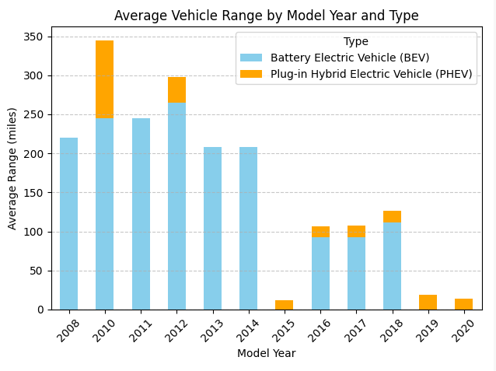
BEV has longer range than PHEV.
2012 has the top Range in BEV class.
PHEV with limited range, had greater sales in 2010.

Slide 9
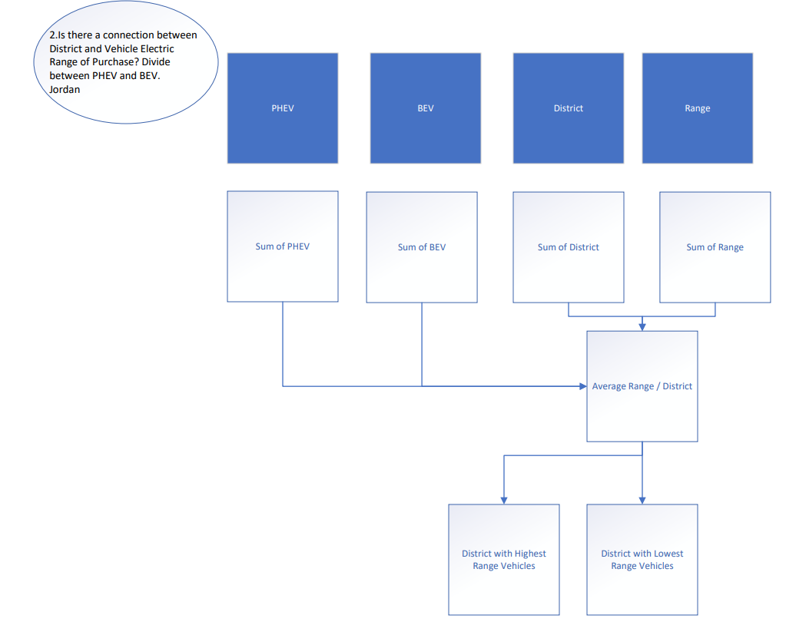
Data Mapping Q3 ( Jordan )

Slide 10
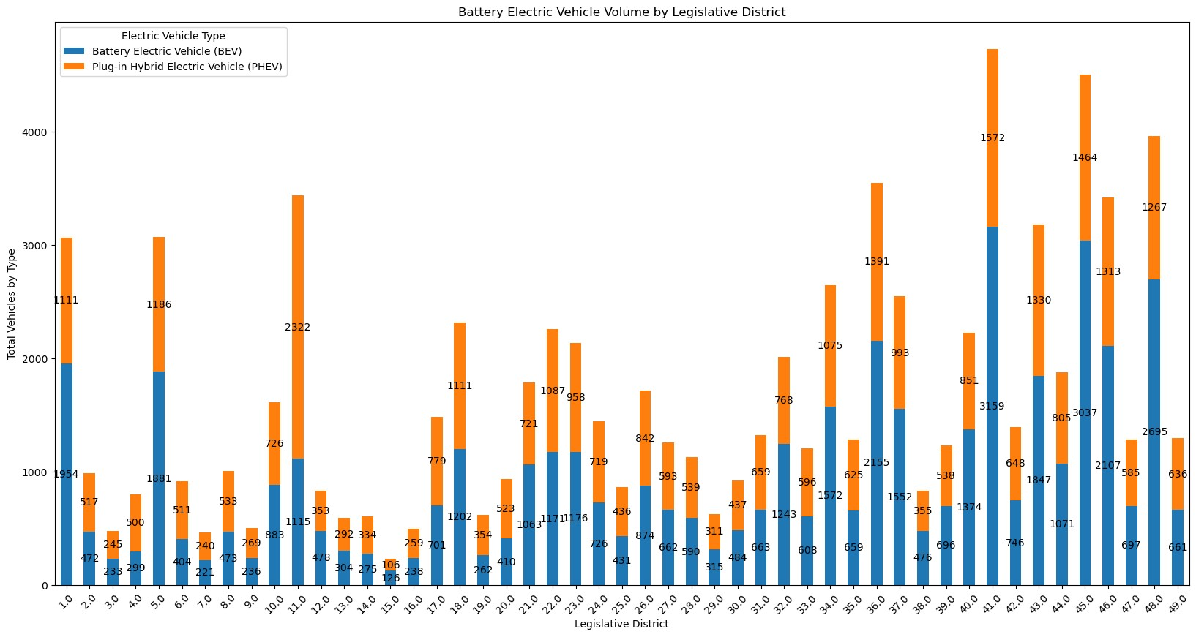
Analysis of Legislative Districts

Slide 11
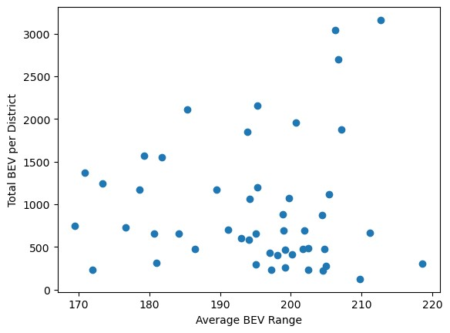
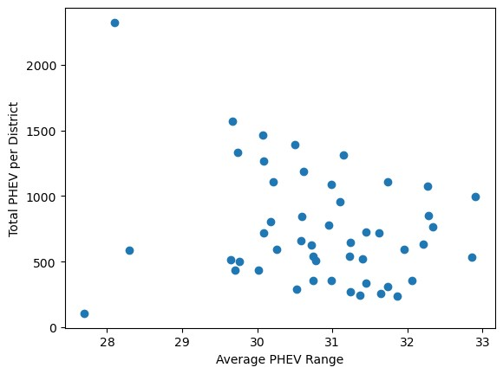
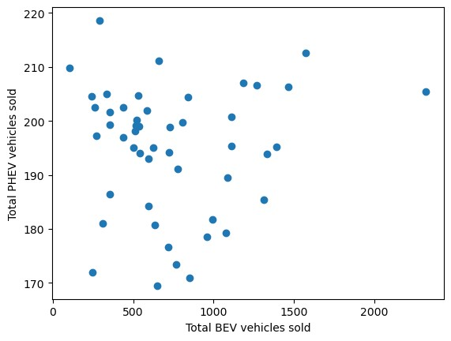
Correlation of Various Comparisons –Legislative District
Average Range between BEV and total Sales in each district
Average Range between PHEV and total Sales in each district
Total sales of BEV to PHEV in each district
Correlation for each comparison is <.05. We can conclude that there is no correlation between PHEV and BEV sales in the legislative districts in Washington state.

